Slide 1
SMART COOKER WHISTLE COUNTER WITH AUTO SWITCH-OFF
NAME: T. MANI SAI LOKESH
REG NO: 192224105
DEP: AI&DS
SUPERVISOR: DR.ARJUN PANDIAN

Slide 2
GAP ANALYSIS
Traditional pressure cookers require constant manual supervision, making cooking inconvenient and time-consuming. Users often face challenges in counting whistles accurately, which leads to inconsistent cooking results and affects food quality. Additionally, there are safety concerns due to the risk of overcooking or overheating, as traditional cookers lack an automatic switch-off feature. The market currently offers limited smart cooking solutions that integrate whistle counting technology, leaving a gap in automation for precise cooking. Furthermore, traditional cookers contribute to energy wastage without an auto switch-off function, increasing household utility expenses. This highlights a clear need for a smart cooker whistle counter with auto switch-off to enhance convenience, safety, energy efficiency, and cooking precision.

Slide 3
PRODUCT DESCRIPTION
The Smart Cooker Whistle Vessel Counter with Auto Switch-Off is a smart kitchen device designed to simplify cooking while ensuring precision and safety. This innovative system automatically detects and counts the whistles of a pressure cooker, switching off the gas stove or induction at the right moment to prevent overcooking.
Equipped with advanced sensor technology, the device accurately tracks cooking progress and ensures consistent results for different food types. The built-in auto shut-off feature enhances safety by preventing overheating or excessive pressure buildup, reducing risks in the kitchen.
Designed for ease of use, the Smart Cooker Whistle Vessel Counter operates efficiently, helping to conserve energy while maintaining cooking accuracy. Its user-friendly functionality makes it a valuable addition to modern kitchens, offering convenience, reliability, and peace of mind during cooking.

Slide 4
COMPARISON
Criteria | Traditional Pressure Cooker | Smart Cooker Whistle Counter with Auto Switch-Off
Whistle Counting | Manual, prone to errors | Automated and accurate whistle detection
Cooking Monitoring | Requires constant supervision | Hands-free operation with automatic alerts
Cooking Accuracy | Inconsistent, due to manual counting | Consistent and precise cooking results
Safety | Risk of overcooking and overheating | Auto switch-off ensures safe operation
Energy Efficiency | High energy consumption without control | Energy-efficient with automatic switch-off
User Convenience | Time-consuming and inconvenient | User-friendly and hassle-free operation
Technology Integration | No smart features | Advanced whistle counting and automation
Market Availability | Widely available | Limited availability in smart cooking solutions

Slide 5
UNIQUENESS
Customizable Alerts: Allow users to set personalized alert tones or vibrations based on the number of whistles or cooking time, adding a personal touch to the user experience.
Intelligent Cooking Modes: Use AI to analyze cooking patterns and suggest ideal settings for different types of food. The system could optimize cooking based on the food's nature and moisture level, offering automatic adjustments.
Safety Shut-off Feature: The device could automatically turn off the cooker if it detects a malfunction, such as an excessive number of whistles in a short period, indicating a potential problem like a blocked vent.
Energy Monitoring: Add energy monitoring features to help users track the cooker’s energy usage and recommend ways to save power while cooking.
Historical Data Log: Enable a feature that logs cooking history with time, temperature, and number of whistles. This data could be useful for improving cooking practices or for troubleshooting recurring issues.
Multi-Device Support: Allow the user to control multiple cookers simultaneously useful for larger kitchens or restaurants.

Slide 6
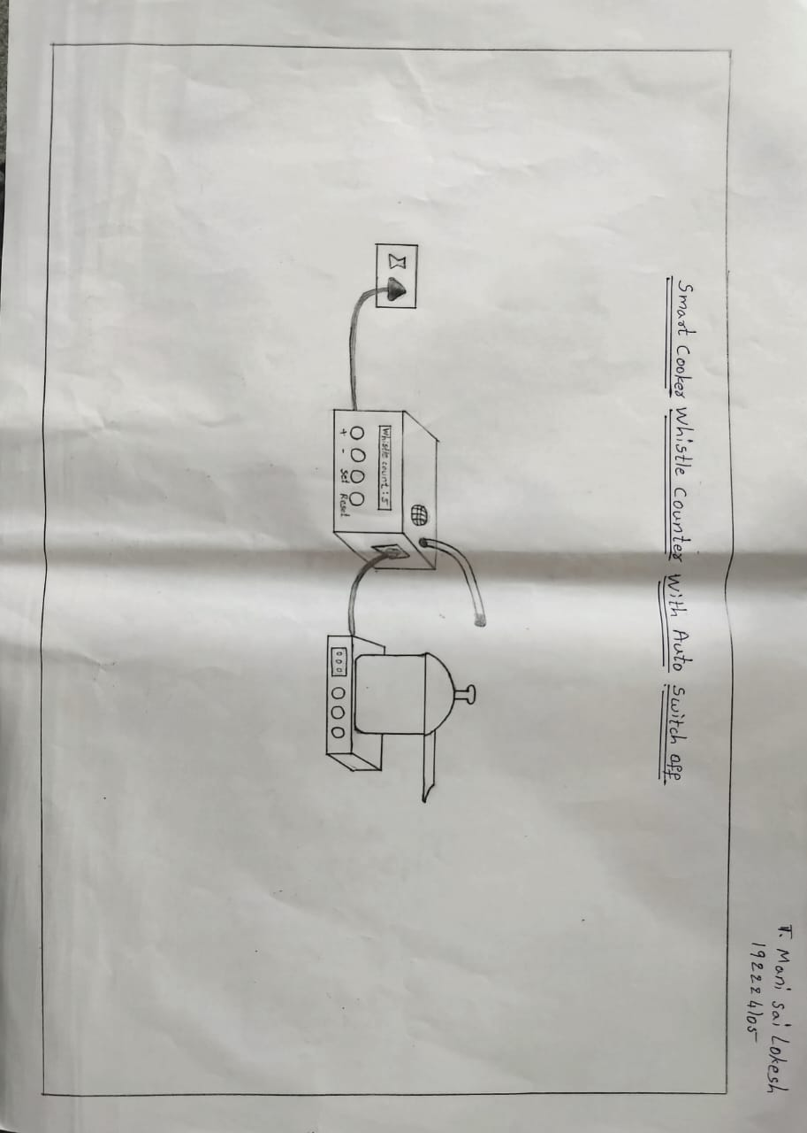
2D DIAGRAM

Slide 7


